Slide 1
Recommending location for a new restaurant
City of Los Angeles

Slide 2

Business
Problem
Recommending optimum location to set up new
Several factors to consider for location
● More populous location
● Younger population groups
● More number of venues
● Distance from the city center
restaurant business.

Slide 3

Data Sources
● Data of Los Angeles population data
2010_Census_Populations_by_Zip_Code.csv
● Foursquare API
○ Number of restaurants
○ other venues in the neighborhood
○ vicinity of the venue

Slide 4

Methodology
Exploratory data analysis of the merged population data and
foursquare API data
○ Grouping by venue categories
○ One hot encoding on categories using get_dummies from pandas library
○ Binary format as input to machine learning algorithm
● Machine Learning Algorithm
○ K-Means Clustering Unsupervised Learning algorithm
■ 6 clusters

Slide 5
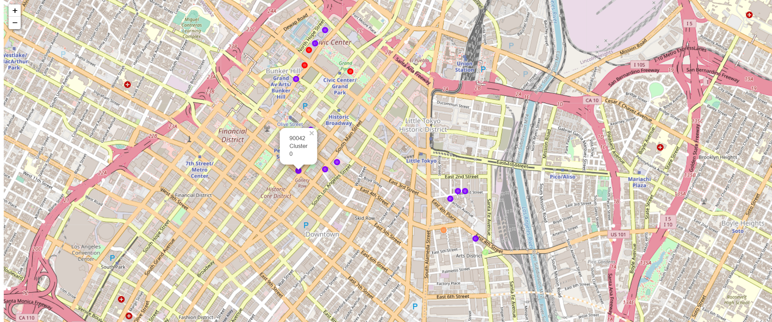
Results
Map different cluster with different color circles

Slide 6
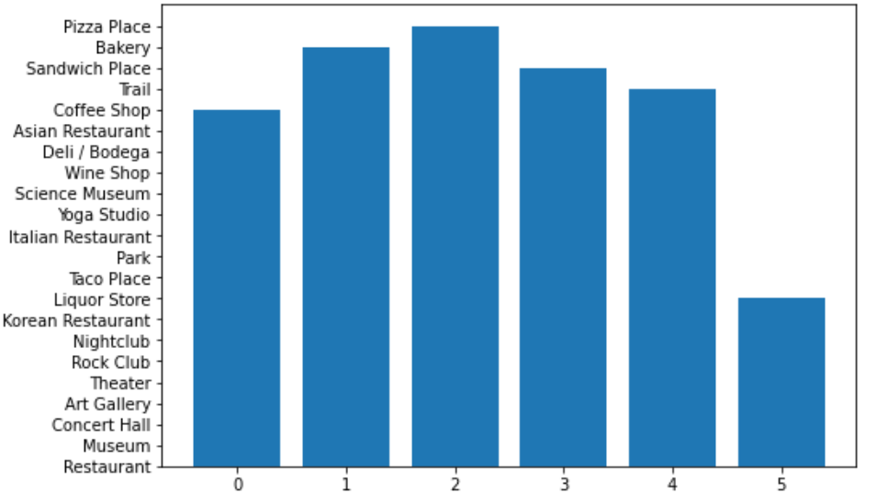
First most common venue for every cluster

Slide 7
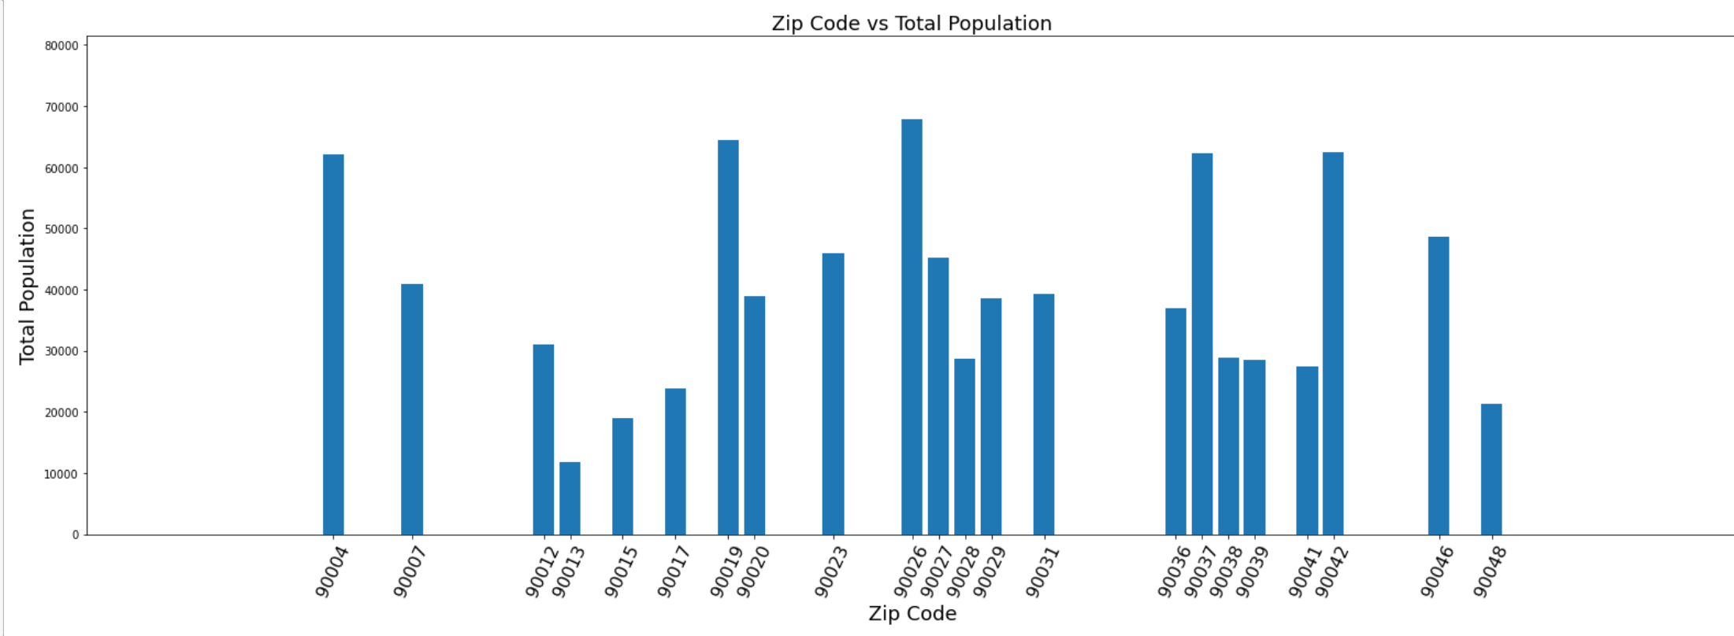
Zip code vs Total Population

Slide 8
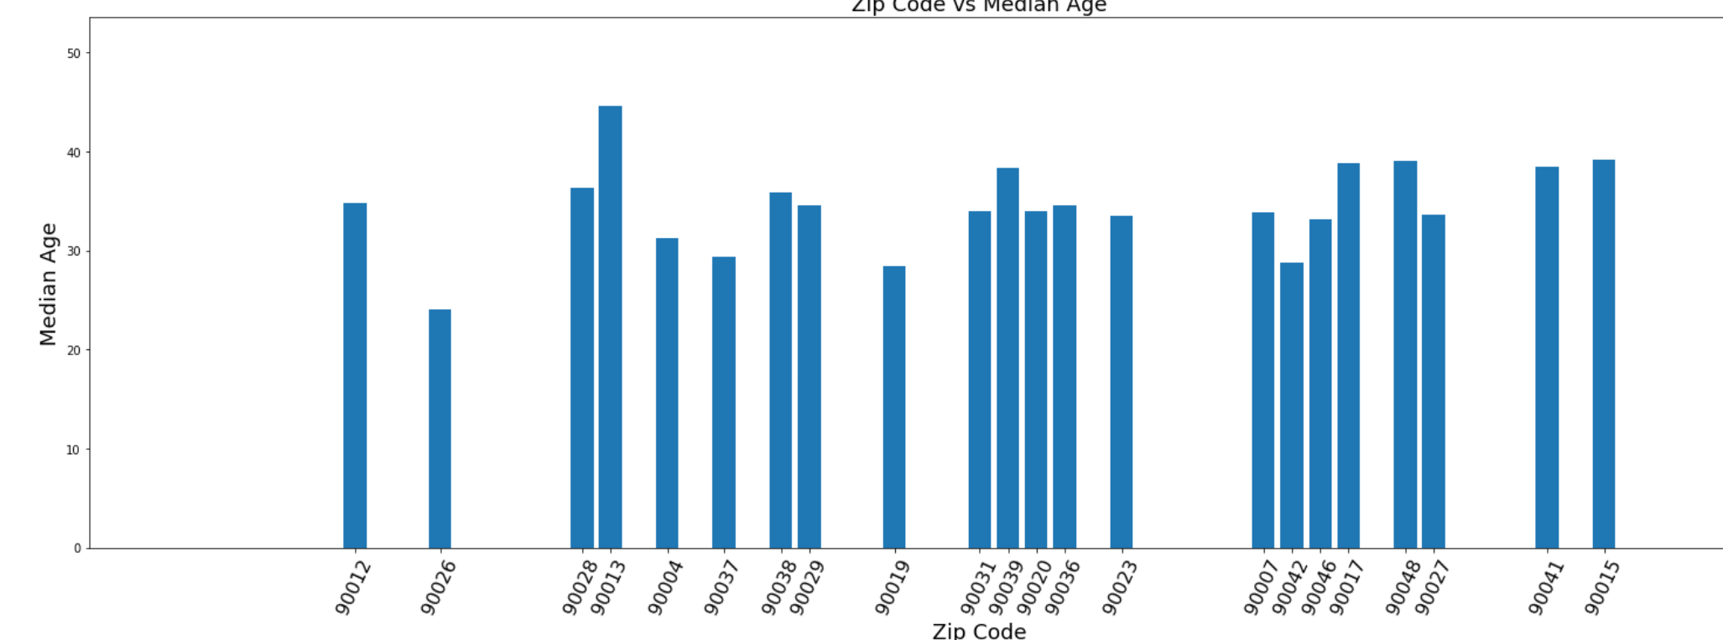
Zip code vs Median Age

Slide 9
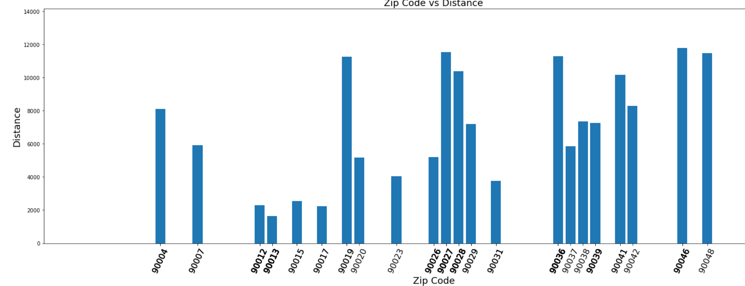
Zip code vs Distance

Slide 10
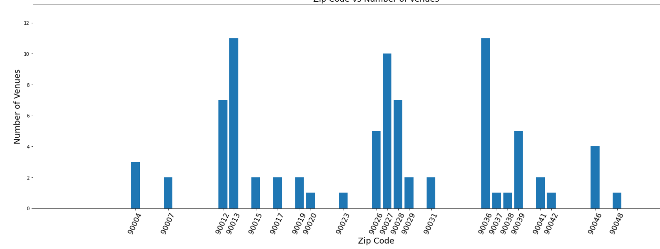
Zip code vs Number of Venues

Slide 11
Analysis of the
Results
As per bar plot for population
90019, 90004, 90016, 90023,
90007 are few zip codes which
are more populous
As per bar plot for median age
shows that 90007, 90023,
90017, 90015, 90016 are few of
zip codes with lesser median age
As per bar plot for distance from
city center shows that 90012,
90013, 90017, 90015, 90023 are
closer to the city center
compared to all the other zip
codes
As per bar plot for the number of
venues shows that 90013,
90012, 90068, 90004, 90007
have more venues in the
respective area compared to all
the other zip codes in the chosen
cluster

Slide 12
Conclusion and
Recommendations
Stakeholder to consider
one or few or all of the
results into consideration
while choosing a location
for his restaurant.
Taking distance and
number of venues into
consideration 90012,
90013 could be
recommended.
Taking population and
median age into
consideration 90007,
90023, 90016 could be
recommended.
Taking median age and
distance into
consideration 90017,
90015, 90023 could be
recommended.

